Slide 1

Variables, Data Types, Operators

Slide 2
Variables
A variable is a named space in memory
Data can be assigned to a variable when we want to access data in the future

Slide 3
Declaring a variable
Variable names should be nouns
Variable names are case sensitive
Good variable names should be descriptive
Reserved keywords cannot be variable names
i.e. public, private, protected, return, if, else, new, for, switch, static, etc.

Slide 4

Assigning a variable
It is best practice to declare variables before assigning values to them.
With that said, it is possible to declare and assign a variable in the same statement.

Slide 5
Data Types
C# is a strongly typed language
That means you must inform the compiler about which data type you would like to use when you declare a variable.
Value Type: assign a value directly to a variable
Reference Type: pointed to the location of where the value is stored

Slide 6
Data Types
int: Value type that stores numbers. 32-bit signed integer type
Default value is 0
char: Value type that stores a single 16-bit Unicode character
bool: Value type that is a Boolean value (True or False)
Default value is false
string: Reference type that stores characters that make up text
Default value is null

Slide 7
Data Types
float: 32-bit (7 digits) floating point type
double: 64-bit (15-16 digits) floating point type
decimal: 128-bit (28-29 digits) floating decimal point type
All three are value types that store numbers

Slide 8
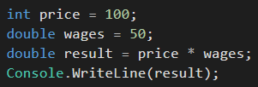
Numbers

Slide 9
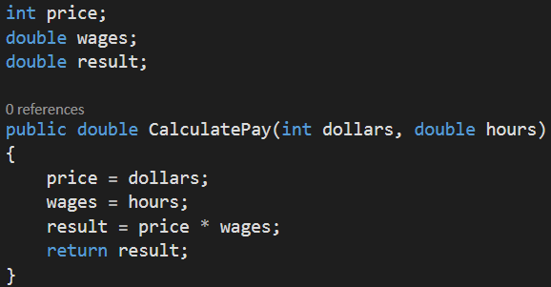
Numbers -- Function Example

Slide 10

Boolean

Slide 11
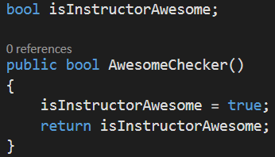
Boolean -- Function Example

Slide 12
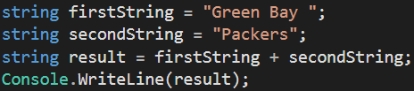
Strings

Slide 13
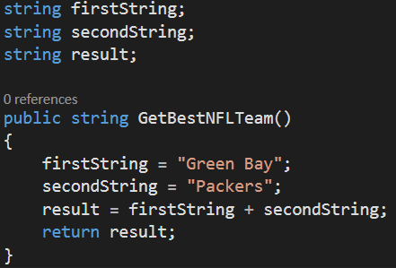
Strings -- Function Example

Slide 14
Operators
Operator Description
+ Addition (also String concatenation)
- Subtraction
* Multiplication
/ Division
% Modulus
++ Increment
-- Decrement

Slide 15
Operator Examples
Operator Example
+ 2 + 2 = 4
- 4 – 2 = 2
* 5 * 5 = 25
/ 10 / 5 = 2
% 4 % 3 = 1
++ 1++ = 2
-- 1-- = 0

Slide 16
Order of Operations is Important
The order of operations can matter a lot when writing code
Order of operations is left to right
Parentheses
Exponents
Multiply
Divide
Addition
Subtraction

Slide 17
Order of Operations Example
4 + 6 * 3 / 2 – (4 -1) + 9 * (3 – (2 * 4)) / 3
Output: - 5

Slide 18
Assignment Operators
Operator Example Same As
= x = y x = y
+= x += y x = x + y
-= x -= y x = x - y
*= x *= y x = x * y
/= x /= y x = x / y
%= x %= y x = x % y

Slide 19
Comparison Operators
Operator Description
== equal to
!= not equal to
> greater than
< less than
>= greater than or equal to
<= less than or equal to

Slide 20
Review Questions
What is a variable?
What is a data type?
What is an example of a data type? Explain.
What does PEMDAS stand for?

Slide 21
Assignment
Pay Calculator
Write a program to prompt the user for hours and rate per hour to compute gross pay.
Enter hours: 35
Enter rate: 2.75
Pay: 96.25

